Slide 1

CREDIT RISK ANALYSIS v.2
Huy Nguyen
ISM 6358
07/09/2023
Slide 1/11

Slide 2
1. BAD Data
Slide 2/11

Slide 3





BAD Data
Usage of certain demographic data is unethical and potentially illegal
Reference: https://www.consumerfinance.gov/ask-cfpb/can-a-lender-or-dealer-consider-my-sex-marital-status-or-dependents-when-deciding-whether-to-give-me-an-auto-loan-en-1191/ https://www.consumerfinance.gov/ask-cfpb/is-a-lender-allowed-to-consider-my-age-or-where-my-income-comes-from-when-deciding-whether-to-give-me-a-loan-en-1181/
Consumer Financial Protection Bureau (CFPB)
Capital
Lack of metrics directly related to the credit risk
Conditions
The 5Cs of Credit Risk
Character
Collateral
Capacity
Reference: https://www.investopedia.com/terms/f/five-c-credit.asp
Static data does not tell the entire picture
Time Series Data
Ex: Car sales peaked during tax return season
Reference: https://santanderconsumerusa.com/blog/do-people-really-buy-new-cars-with-their-tax-refunds
Slide 3/11

Slide 4
2. Findings
Slide 4/11

Slide 5
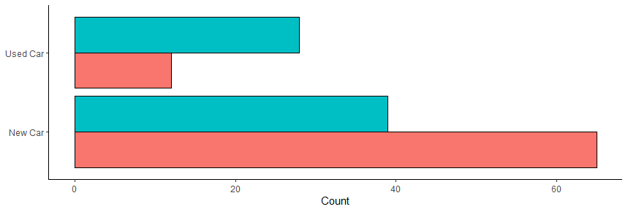


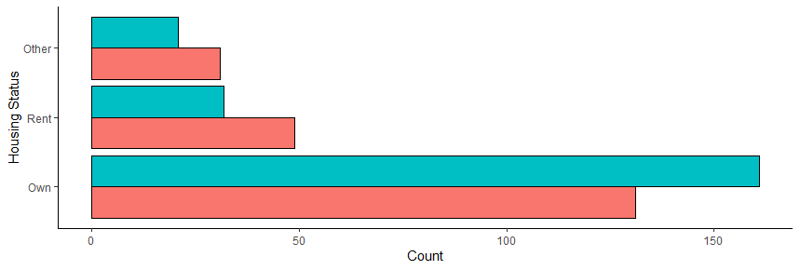

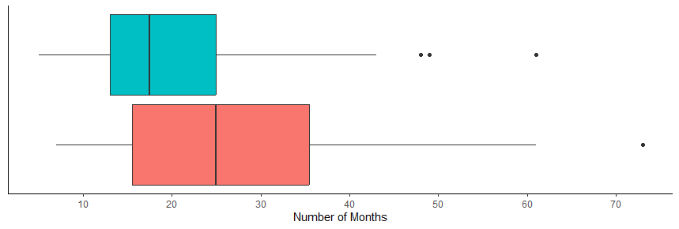

LOGISTIC REGRESSION
*
Loan Purpose
.
LOGISTIC REGRESSION
Housing Status
.
Low Risk
Customer Lifetime (months)
High Risk
***
Slide 5/11

Slide 6
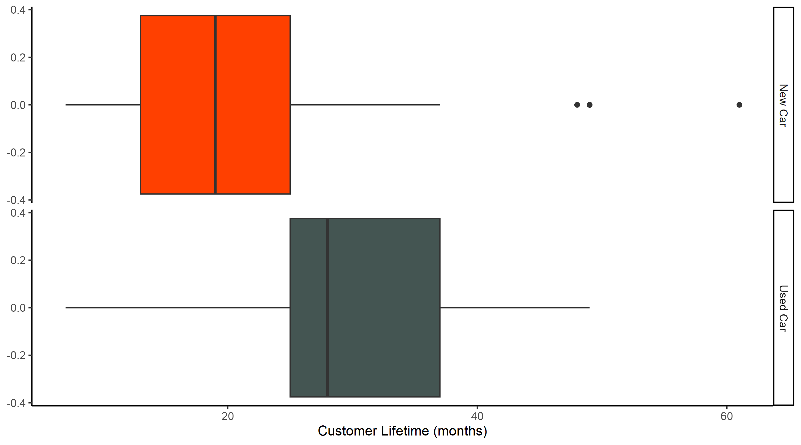
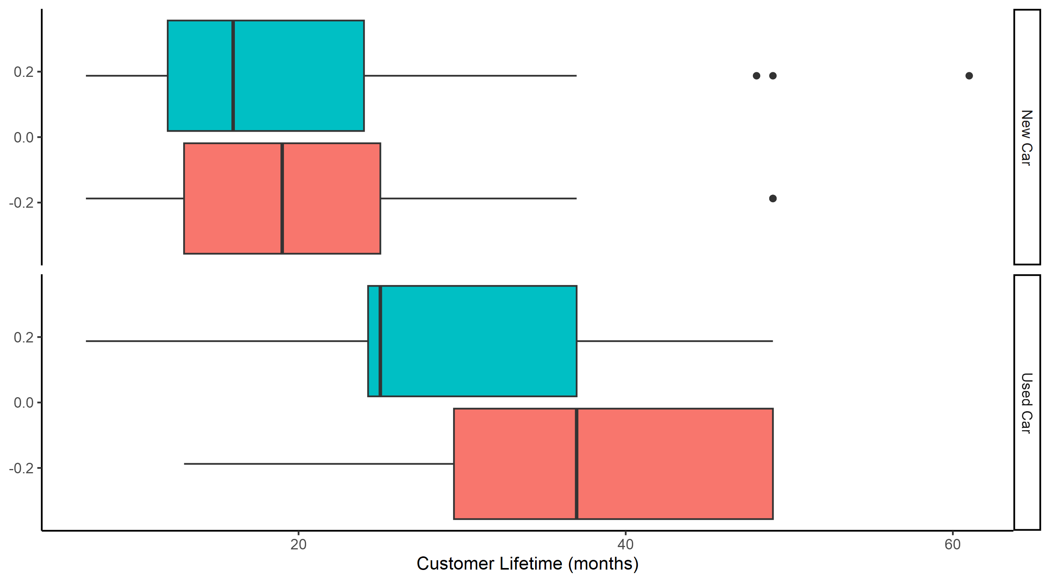
CUSTOMER LIFETIME
New customers prefer new cars whilst longtime customers prefer used cars instead.
Age was not a contributing factor
New Car
Used Car
High Risk
Low Risk
No significant difference in customer lifetime between high and low credit-risk customers who purchase new cars.
Significant difference in customer lifetime between high/low credit risk customers who purchase used cars.
Slide 6/11

Slide 7
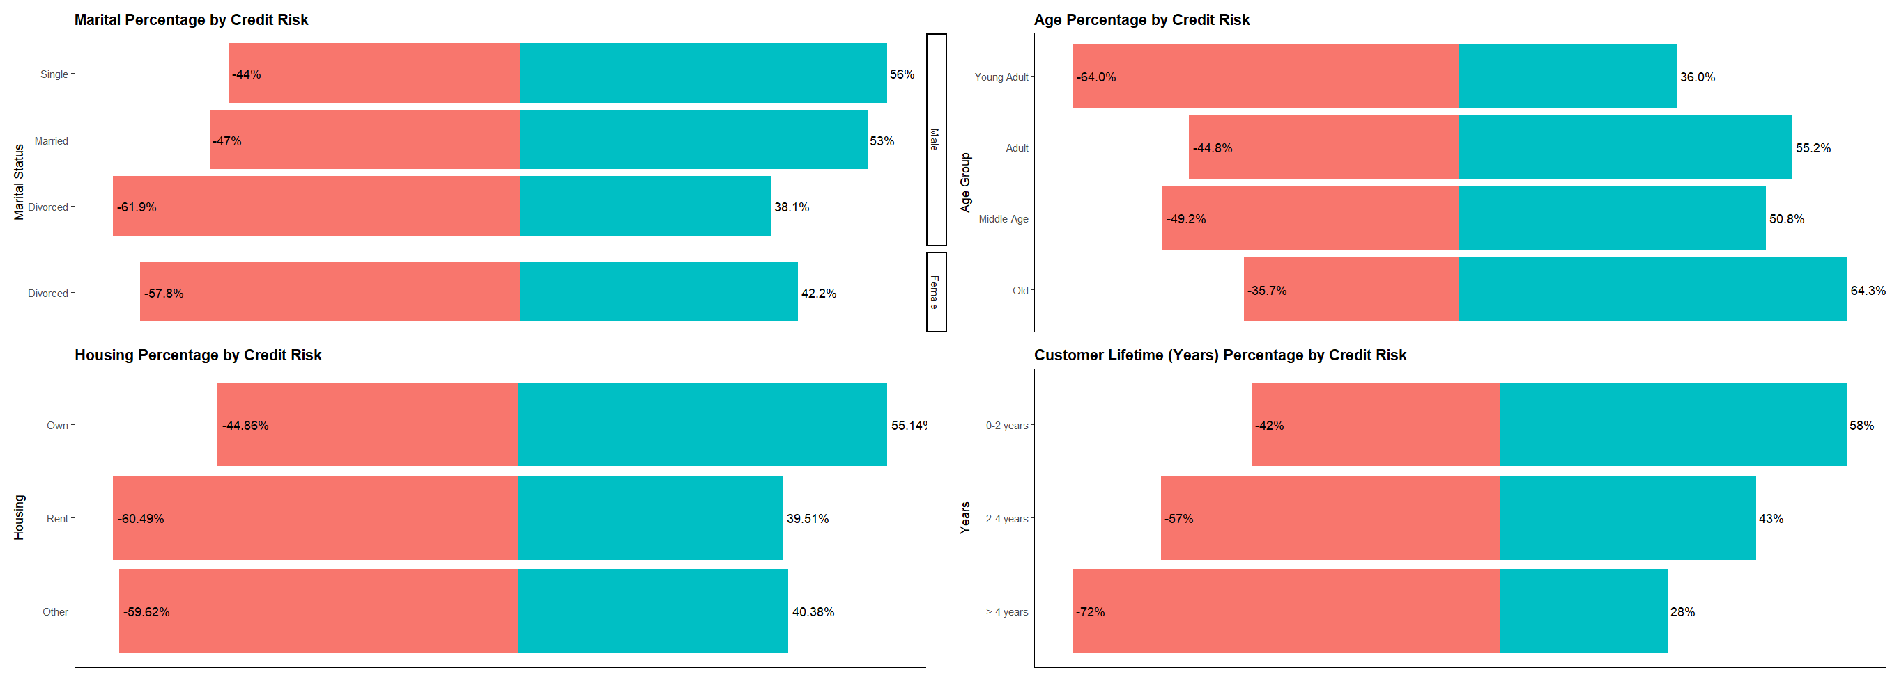
DEMOGRAPHIC TRENDS
Slide 7/11

Slide 8
DEMOGRAPHIC - RECOMMENDATIONS
Risk-Based Pricing
Longer Terms
Promotions
Credit Insurance
Diversifying Borrower Pool
Slide 8/11

Slide 9
3. Conclusions
Slide 9/11

Slide 10
3Ws
Reverse engineering this oddball dataset was fun
More charts
The acceptance of the cruel reality of data analytics in the real world
No dashboard
Could’ve been more focused
More questions than answers
Slide 11/11

